Slide 1



PUB
LIC
on 11.11.20-20.11.20
PROGRESS REPORT OF THE PROJECT
Speaker:Khokhnaikyzy Altyngul

Slide 2
PROJECT
DEFINITION

Slide 3

PROJECT DEFINITION
PURPOSE
THEME
help put everything in place
Education course "oxford street" PUBLIC
IMPORTANCE
DESCRIPTION
The purpose of this project will allow a list of students. can store ields test. full information of students and teachers. all groups. salary of working students. scholarships of students. The most convenient is the distribution of classrooms where the lessons will be held and, accordingly, the time.
The part of the job is the external work of the whole University/school

Slide 4



REPORT FOR
11.11.2020
Progress report for 11.11.2020 Day 1. I started creating a "draft version" of the ERD for other tables called "PUBLIC" It links to other tables.
Question 1: Write the question you want to ask your students and allot space for the answers.

Slide 5
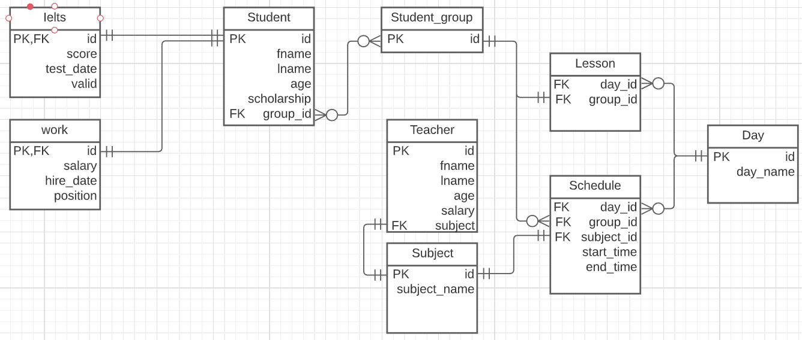

ERD
OF THE PROJECT

Slide 6
REPORT FOR
12.11.2020
Progress report for 11/12/2020. Day 2. Today I create a full ERD version of my project types for each table. There are 6 tables in total.

Slide 7


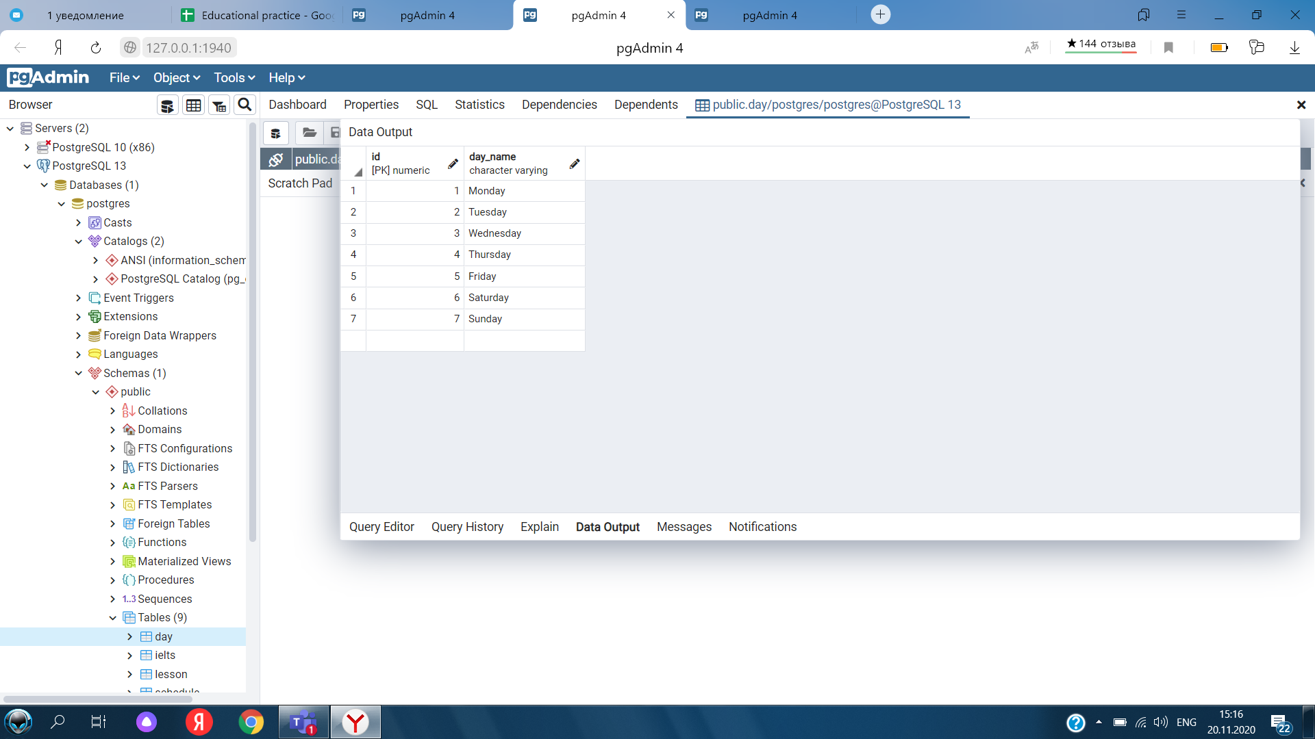
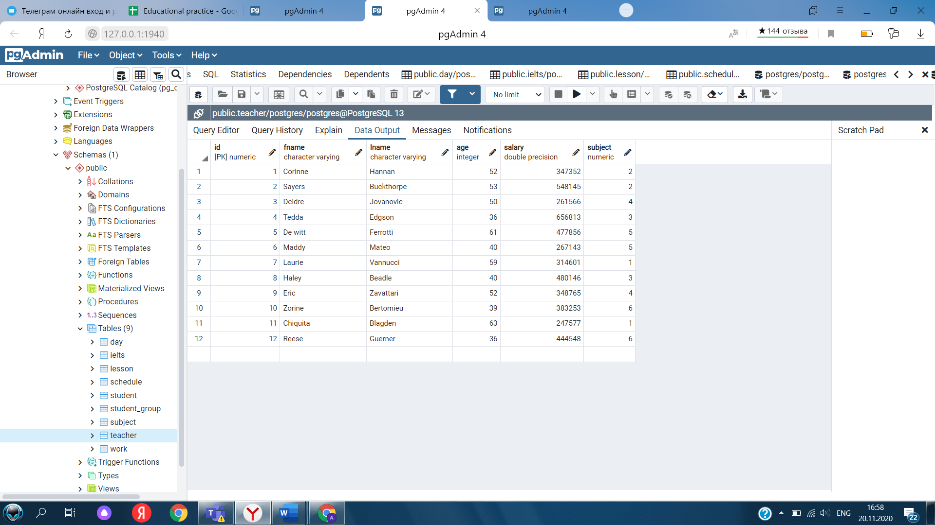
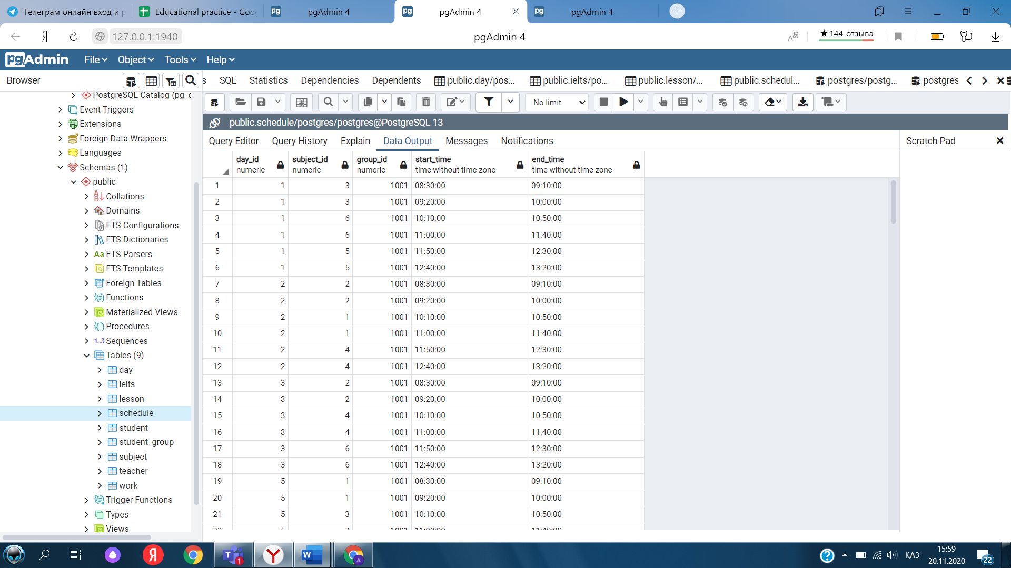
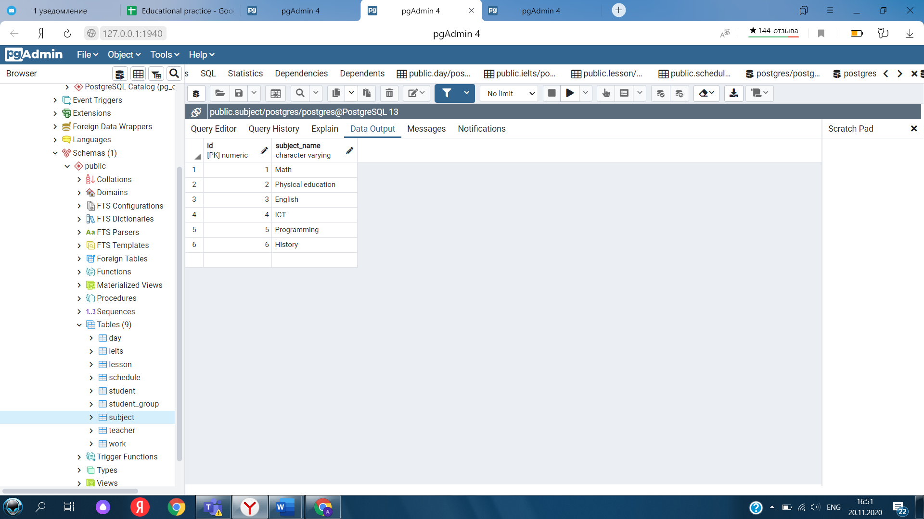
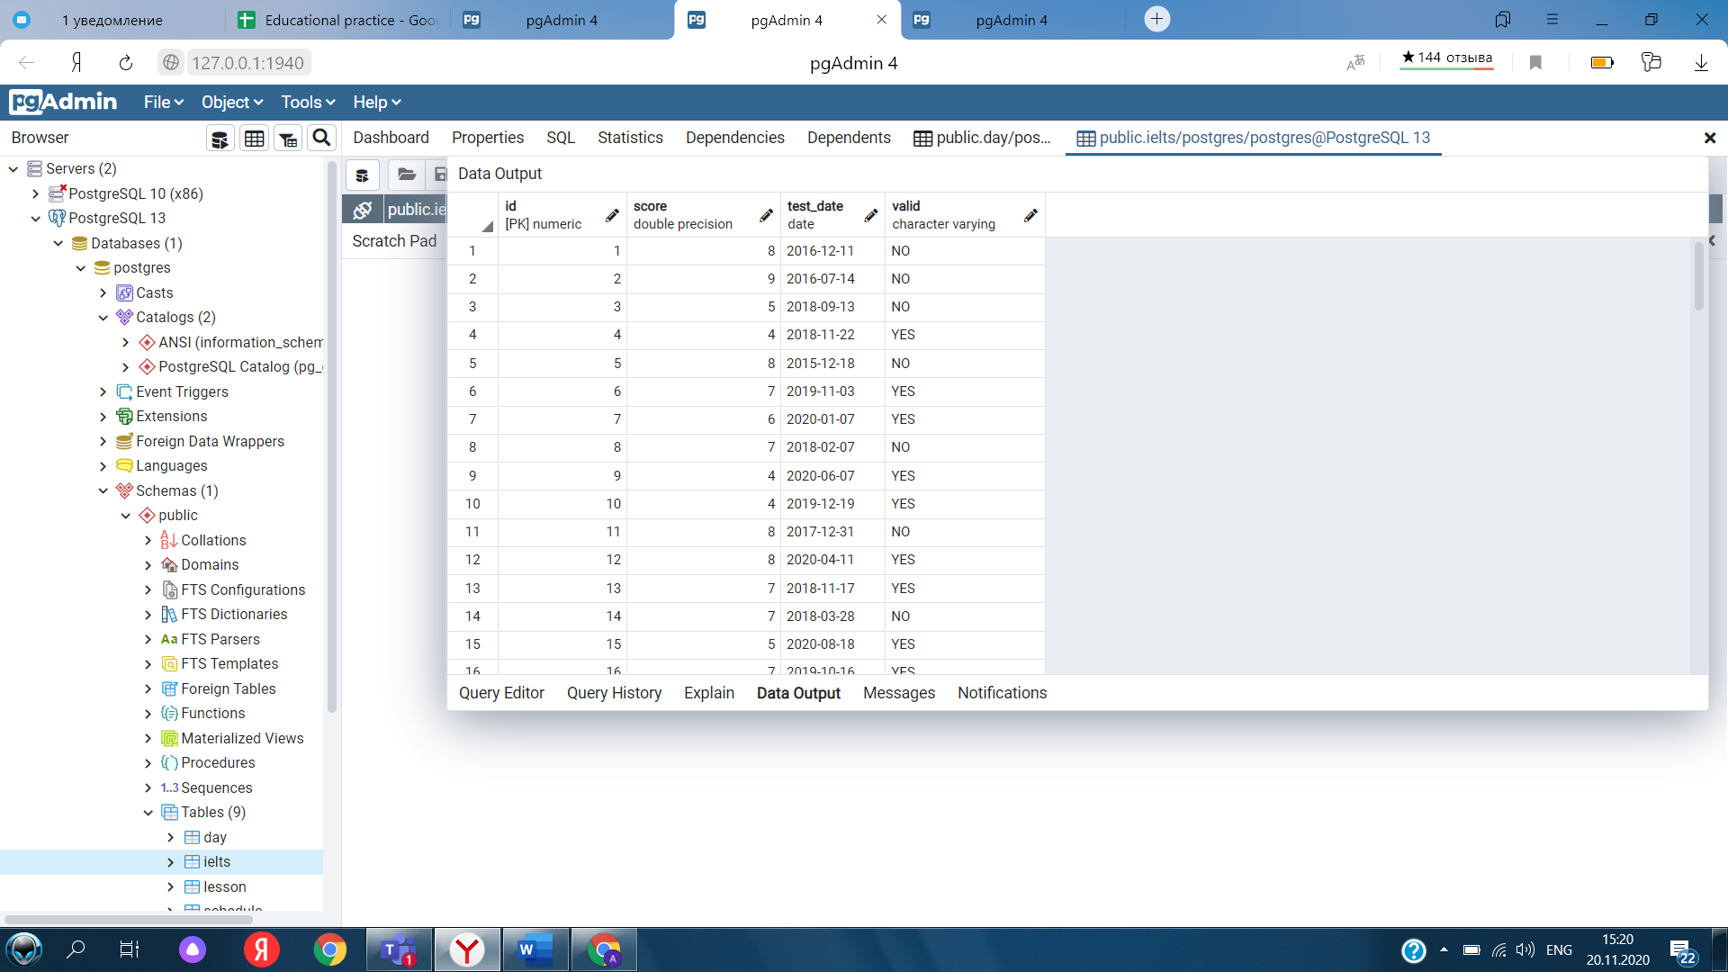
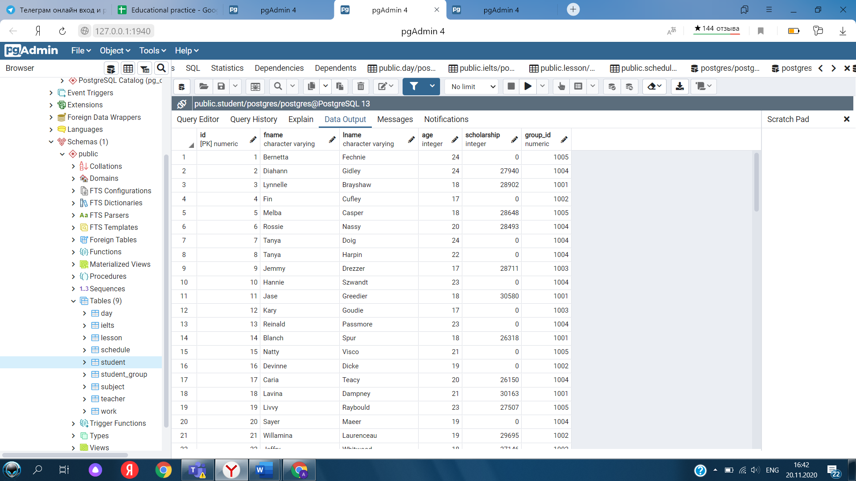
SQL TABLES

Slide 8



REPORT FOR
13.11.2020
Progress report for 11/13/2020. Day 3. After creating the ERD of my project, today I was able to use foreign keys, primary key and date constraints such as loading the ERD and codes there.

Slide 9
REPORT FOR
17.11.2020
The topic of today's lecture on C + was pointers. She showed the basics and solved some problems. I think it was helpful for everyone to listen to this, because the teacher explained everything well and clearly. At the guest lecture, we discussed a very interesting topic: UMUX and product design, I think many students were interested. Having gone through some of the advantages and disadvantages of this profession, she has high salaries and creative fulfillment. I am transferring to media soon. And in general I liked her.
Question 1: Write the question you want to ask your students and allot space for the answers.
Question 1: Write the question you want to ask your students and allot space for the answers.

Slide 10
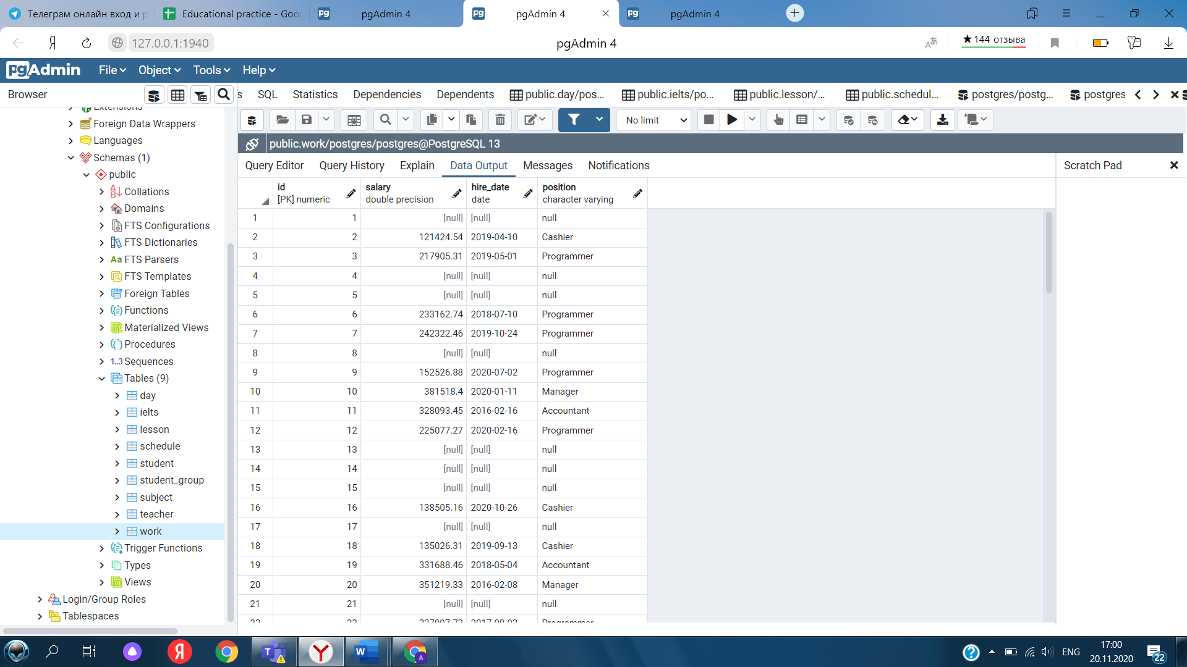

UPDATE
UPDATE public.work
SET salary=null
WHERE hire_date is null;
UPDATE public.work
SET
"position"='Cashier'
where salary>=100000 and
salary <=150000
UPDATE public.work
SET
"position"='Programmer'
where salary>150000 and
salary <=250000
UPDATE public.work
SET
"position"='Accountant'
where salary>250000 and
salary <=350000

Slide 11
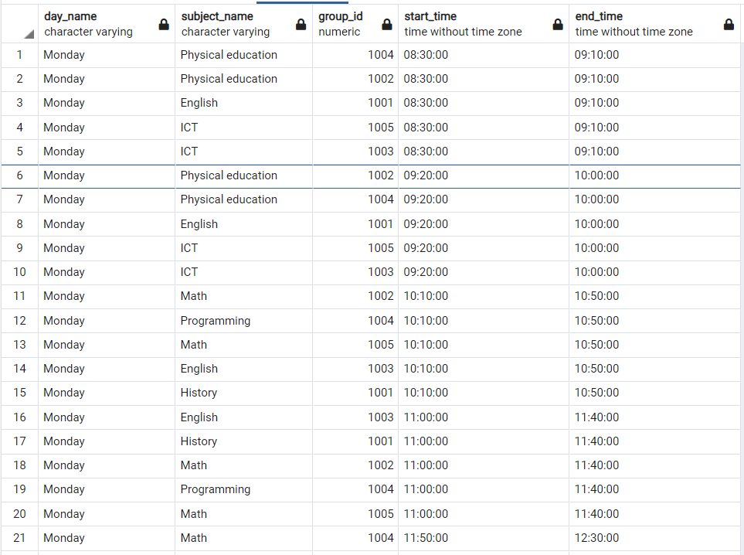

TO FIND OUT THE MONDAY SCHEDULE FOR EACH GROUP:
SELECT day.day_name, subject.subject_name, group_id, start_time,
end_time
FROM public.schedule
join subject on
id=subject_id
join day on day_id=day.id
where day_id=1 //1
– Monday, 2 – Tuesday и т.д.
order by
start_time

Slide 12
HUGE THANKS TO EVERYONE !

